Slide 1
THE HYDROBOT

Slide 2








OUR TEAM
NEHA NAIR
PES1UG23AM182
NESARA ANAND RAJ
PES1UG23EC197
NIRANJINI ANAND
PES1UG23CS398
NUPUR N DAMBAL
PES1UG23EC210
NEHA SATISH DIXIT
PES1UG23EC195

Slide 3
TABLE OF CONTENTS
01
Problem vs. solution
03
Costs and Profit Analysis
02
Our product
04
Business model

Slide 4
01
Problem vs. solution

Slide 5
PROBLEM STATEMENT
In an era where water quality is increasingly under threat from pollution and contamination, ensuring access to clean and safe drinking water has become a paramount concern. Overall, the project aims to address the multifaceted challenges posed by water contamination. By tackling this critical issue, the project seeks to safeguard public health, preserve environmental integrity, and promote the equitable access to clean and safe water for present and future generations.

Slide 6
SOLUTION
The HYDROBOT is an innovative water quality monitoring device with a sophisticated alert system at its core. The alert system is designed to detect deviations from established water quality standards, promptly notifying users through mobile notification, or visual and auditory indicators on the device itself. This real-time monitoring and alerting capability empower users to take immediate actions such as water treatment or maintenance, ensuring access to safe and clean drinking water while contributing to public health protection and environmental sustainability efforts.

Slide 7
1 to 3 million cholera cases every year.
21000 to 1,43,000 deaths due to cholera every year.

Slide 8
CASE STUDY
Challenge
Results
Solution
Around 7-10 hostel students tested positive for cholera and rest were said to have gastroenteritis
A few days ago news regarding cholera outbreak in Bangalore was making rounds and the reason for this outbreak was found to be contamination of water.
Thus Hydrobot would play a vital role here by alerting the organisation about the contamination and impurity level present in the water being used.

Slide 9
02
Our Product

Slide 10

PRODUCT OVERVIEW(ALERT SYSTEM)
1
2
In view of any further negligence, the respective higher authorities are notified.​
Hygiene levels are inspected. In case of any violation from the recommended levels, the device alerts the institution in-charge.​
4
This results in a strike given to the institution, and strict action will be taken once three strikes are recorded, followed by a visit from an appointed government official.
A fine will be levied for the negligence shown, the fine being higher for every instance recorded.​
3

Slide 11
Purifier
The HYDROBOT
The HYDROBOT is a device that focuses on early detection of contaminants, and alerts the user to potential quality issues.
A water purifier is a device that detects and removes contaminants from water and makes it safe for drinking purposes.

Slide 12
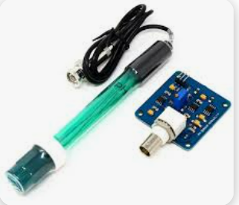
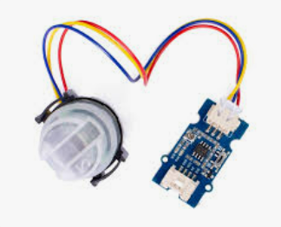
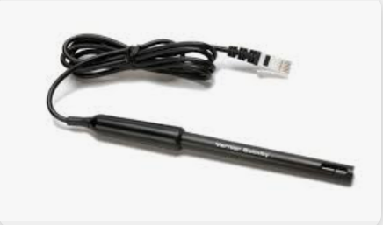
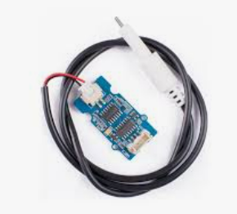
SENSORS TO BE EMPLOYED
PH SENSOR
OPTICAL DENSITY/TURBDITY SENSOR
SALINITY SENSOR
TDS SENSOR

Slide 13
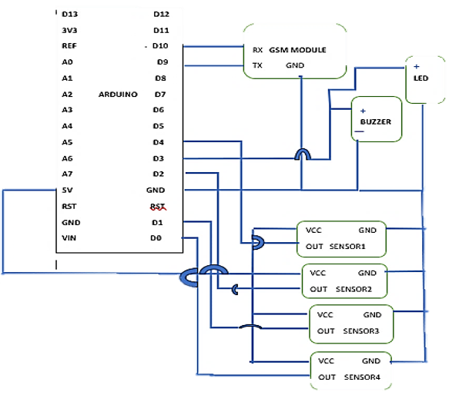
CIRCUIT DIAGRAM

Slide 14
SWOT ANALYSIS
1.Real Time Data Analysis​
2. Modular Design​
1.Connectivity dependance​
2.Maintenance requirements​
Strengths
Weaknesses
S
W
O
T
1.Economic Factors
2.Supply chain disruptions​
1.Product Diversification​
2.Data analytics service
Opportunities
Threats

Slide 15
OUR PLANS
01
02
03
Regular Water
STP Water
Groundwater
Groundwater also contains few to many impurities and our next goal will be to check impurity levels in groundwater
Our main focus as of now is detecting the impurity and contamination levels in regular water
After the success of the regular water model we will move on and create a model for STP Water

Slide 16
03
Costs and Profit Analysis

Slide 17
COST STRUCTURE
BASIC
INTERMEDIATE
ADVANCED
1.PVC PIPES
2.BATTERY
3.ENCLOSURE SYSTEM
1.LED’S
2. BUZZERS
3.MICROCONTROLLE-RS
4.GSM MODULE
1. DIFFERENT VARIETY OF SENSORS
800-1.3K
3.2-4.4K
1.5-2K

Slide 18
COST-BENEFIT ANALYSIS
CALCULATION OF NET PRESENT VALUE:
To calculate the NPV (Net Present Value) for The Hydrobot project over a period of 5 years, we will consider the cash flows for each year and discount them to their present values based on a discount rate of 10%. Given: -
Initial Investment (Cost per Unit) = 9,600 rupees
- Selling Price per Unit = 15,000 rupees
- Number of Units Produced (Sold) = 1
- Discount Rate = 10%
Cash Flows:
- Year 1: Revenue - Cost = 15,000 - 9,600 = 5,400 rupees
- Year 2: Revenue - Cost = 15,000 - 9,600 = 5,400 rupees
- Year 3: Revenue - Cost = 15,000 - 9,600 = 5,400 rupees
- Year 4: Revenue - Cost = 15,000 - 9,600 = 5,400 rupees
- Year 5: Revenue - Cost = 15,000 - 9,600 = 5,400 rupees

Slide 19
Factors:
- Discount Factor Year 1 = 1 / (1 + Discount Rate)^1 = 1 / (1 + 0.10)^1 = 0.9091 (rounded off)
- Discount Factor Year 2 = 1 / (1 + Discount Rate)^2 = 1 / (1 + 0.10)^2 = 0.8264 (rounded off)
- Discount Factor Year 3 = 1 / (1 + Discount Rate)^3 = 1 / (1 + 0.10)^3 = 0.7513 (rounded off)
- Discount Factor Year 4 = 1 / (1 + Discount Rate)^4 = 1 / (1 + 0.10)^4 = 0.6830 (rounded off)
- Discount Factor Year 5 = 1 / (1 + Discount Rate)^5 = 1 / (1 + 0.10)^5 = 0.6209 (rounded off)
NPV Calculation:
NPV = (Cash Flow Year 1 * Discount Factor Year 1) + (Cash Flow Year 2 * Discount Factor Year 2) + ... + (Cash Flow Year 5 * Discount Factor Year 5)
- Initial Investment NPV = (5,400 * 0.9091) + (5,400 * 0.8264) + (5,400 * 0.7513) + (5,400 * 0.6830) + (5,400 * 0.6209) - 9,600 NPV = 4,909.4 + 4,464.6 + 4,052.62 + 3,685.2 + 3,351.6 - 9,600 NPV = 20,463.52 - 9,600 NPV = 10,863.52 rupees (rounded off)
The NPV for The Hydrobot project over 5 years, considering the given cash flows and discount rate, is approximately 10,863.52 rupees. This positive NPV indicates that the project is financially viable and may generate positive returns over the specified time horizon.

Slide 20
RETURN ON INVESTMENT(ROI)
-ROI = (Total Profit / Total Investment) * 100
Total Investment = Cost per Unit * Number of Units
Total Investment = 9,600 rupees * 100 units
Total Investment = 960,000 rupees
ROI = (540,000 rupees / 960,000 rupees) * 100
ROI = 56.25%
This financial draft demonstrates that producing and selling The Hydrobot units can be profitable, with a projected total profit of 540,000 rupees in the first year. The profit margin is calculated at 36%, indicating a healthy return on each unit sold. The ROI is estimated at 56.25%, showing that the investment in production costs can generate significant returns. These figures provide a snapshot of the potential profitability of The Hydrobot project based on the specified assumptions and sales volume.

Slide 21
FINANCIAL DRAFT: PRODUCTION PROFITABILITY FOR THE HYDROBOT
Assumptions:
Cost per Unit (Production-Manufacturing Costs): 9,600 rupees
- Selling Price per Unit: 15,000 rupees.
Calculation of Profit per Unit:
- Profit per Unit = Selling Price per Unit - Cost per Unit
- Profit per Unit = 15,000 rupees - 9,600 rupees
- Profit per Unit = 5,400 rupees.
Total Profit Projection:
- Assuming production and sale of 100 units in the first year:
Total Profit = Profit per Unit * Number of Units
Total Profit = 5,400 rupees * 100 units
Total Profit = 540,000 rupees.
Profit Margin:
- Profit Margin = (Total Profit / Total Revenue) * 100
Total Revenue = Selling Price per Unit * Number of Units
Total Revenue = 15,000 rupees * 100 units
Total Revenue = 1,500,000 rupees
Profit Margin = (540,000 rupees / 1,500,000 rupees) * 100
Profit Margin = 36%5

Slide 22
04
Business Model

Slide 23
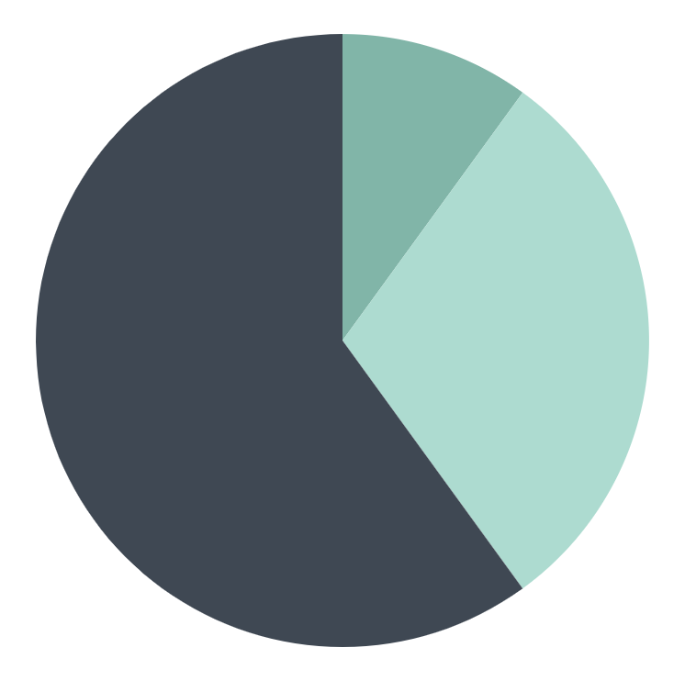
MARKET SIZE
60%
30%
10%
EDUCATIONAL AND PRIVATE ORGANISATIONS
RESIDENTIAL AREAS (APARTMENTS)
GOVERNMENT AIDED INSTITUTIONS

Slide 24
BUSINESS MODEL
VALUE PROPOSITION
Comprehensive real-time water quality monitoring solution.
CUSTOMER SEGMENTS
Residential, commercial, industrial, educational, environmental, and agricultural sectors.
REVENUE STREAMS
Product sales, subscription
based services, partnerships.

Slide 25
BUSINESS MODEL
CHANNELS
Online sales platforms, e-commerce, distributors, digital marketing.
CUSTOMER RELATIONSHIP
Strong support, training, feedback collection.
KEY ACTIVITIES
R&D, manufacturing, marketing, sales.

Slide 26
BUSINESS MODEL
PARTNERSHIPS
Water treatment companies,
technology partners, research institutions
FUTURE EXPANSIONS
Geographical expansion, sustainability initiatives.
KEY RESOURCES
Skilled professionals, technology, partnerships.

Slide 27
TIMELINE
Months 1-3
Months 4-6
Months 7-9
Months 10-24
Month 1: Initial planning and research
Months 2-3: Prototype development
Months 4,5,6: Manufacturing Setup and Regulatory Compliance and Certifications
Month 7:
Marketing and Branding Prep
Months 8-9:
Website Development and Online Presence
Months 10-12:
Product Launch and Sales Kickoff
Months 13-24:
Growth and Expansion

Slide 28
SOCIAL SIGNIFICANCE
Promotes active cleaning of water in institutions.
Decreases the case of water borne diseases.
Creates awareness about the importance of clean water.

Slide 29
THANK YOU

